Slide 1
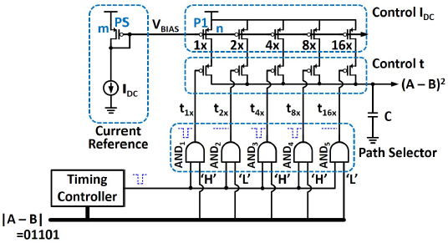
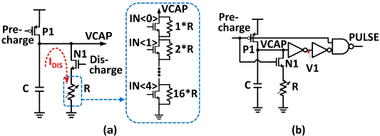
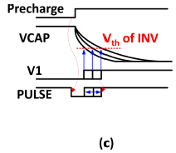
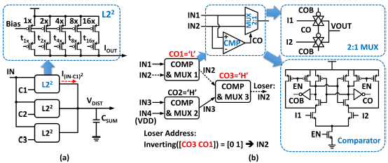
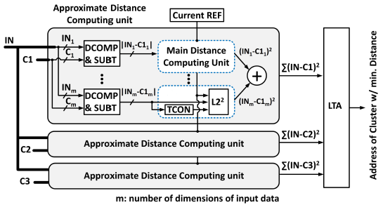
Energy Efficient Distance Computing: K-Means Clustering with Approximate Mixed-signal Design
Chunghee Jang and Kwang-Hyun Baek
Department of Electrical and Electronic Engineering, Chung-Ang University
E-mail : kbaek@cau.ac.kr
Introduction
This study focuses on the distance calculation metric between two multidimensional vectors. As a specific example, we will consider the application of this metric to K-means clustering algorithms, one of the simplest clustering methods commonly used in various areas, such as artificial intelligence, pattern recognition and image segmentation. In addition to the possible applications mentioned above that can utilize the K-means clustering algorithm, theoretical studies have recently been proposed to improve the clustering algorithm itself based on improved distance metrics, such as adaptive fused distance and S-distance. However, despite the theoretical study and application of K-means clustering, efficient hardware implementation does not appear to have yet been achieved despite the simple and repetitive multiplication and addition operations required for distance calculation. Apart from the most intuitive approach to implementing clustering algorithms based on digital logic gates, various distance computing methods using analog and mixed-mode design have been proposed in the literature. As is well known, the digital-based approach can provide the most accurate and fast operating speed at the cost of area and power, while analog methods have comparable precision characteristics despite their simple structure. The main contributions of the proposed research are as follows: (1) A mixed-signal approximate distance calculation core capable of calculating the Manhattan distance or Euclidean distance square between two multidimensional vectors was proposed. (2) It has been successfully shown that the proposed distance computing unit can be exploited in K-means clustering hardware based on a circuit-application co-simulation framework.
Fig. 1. Proposed approximate distance computing unit
Fig. 2. (a) Basic circuit of the timing controller, (b) proposed PWM citcuit with RC discharging path, (c) timing diagram and expected waveforms for the controller
K-means clustering unit
As discussed earlier, the basic computational units for the distance metric are multiplication and addition. In this work, we propose a mixed signal design for the distance computing unit to address the above limitations. The inspiration behind our approach arises from the fact that the voltage V across a capacitor C being charged by a constant current source i for an integration time t is proportional to the input current multiplied by the integration time as follows: V = (i*t)/C. The complete design of the approximate multiplier proposed in the previous section with peripherals is illustrated in Figure 1. The individual components are: (1) current reference circuit to provide a bias voltage VBIAS to the current-mode DAC, (2) Timing controller to control the integration time proportional to the magnitude of the input vector, and (3) Path selector to turn on/off the proper current path depending on the input vector. Hence, the input current magnitude to the capacitor is modulated depending on the value of |A-B| by the current mode DAC. The main function of the Timing controller in Figure 1 is Pulse Width Modulation (PWM), such that the output pulse width varies in accordance to the magnitude of the input. This can be achieved by providing the clock signal as input to an inverter chain and subsequently combining any of the two outputs from the inverter chain appropriately to form an output pulse with varying width. However, such a circuit involves significantly high switching power and area overhead. Hence, we propose a clock-less PWM circuit by utilizing the time constant of a discharging RC circuit path to control the pulse width. Figure 2a demonstrates the circuit details for the PWM unit. Figure 2b,c depicts the details of the proposed PWM unit and its timing diagram, respectively. we will describe two additional circuits required at the last stage of the K-means clustering module, namely the summation and Loser Take All (LTA) units. Hence, by connecting all the outputs from the L2² units to a single capacitor, the summation can be performed at the junction without any additional circuitry (Figure 3a). Figure 3b demonstrates the block diagram of the LTA unit comprising of 2:1 multiplexers (MUXs) and comparators (COMPs). The inputs to the LTA are analog voltages from each “Approximate Distance Computing Unit”. To define a loser with a short latency, a cell-based tree topology has been used here. Once two input voltages are received by an unit cell of the LTA, the comparator determines the smaller input and subsequently transmits the voltage level of the loser through the transmission gate-based 2:1 MUX. A major advantage of this cell-based tree structure lies in its inherent loser address decoder. Hence, the proposed “Approximate Distance Computing Unit” can produce the output address of the lowest distance without any additional Analog-to-Digital Converter (ADC).
Fig. 3. (a) Summation Unit for the proposed “Main Distance Computing Unit”; (b) Loser-Take-All (LTA) circuit based on cell-based tree structure and its inherent address decoding property
Fig. 4. Architecture of the proposed “ K-means clustering unit”
Performance analysis
Fig. 5. (a) Comparison of the energy consumption of the proposed distance computing unit with respect to digital CMOS technology; (b) energy consumption of each component of the proposed design; (c) component-wise energy comparison with digital CMOS implementation.
Acknowledgment
The chip fabrication and EDA tool were supported by the IC Design Education Center (IDEC), Korea.

